Slide 1

CodeX Beverage Survey Analysis Using MySQL

Slide 2
Business Objective
CodeX is a German beverage company that is aiming to make its mark in the Indian market. A few months ago, they launched their energy drink in 10 cities in India.
Their Marketing team is responsible for increasing brand awareness, market share, and product development. They conducted a survey in those 10 cities and received results from 10k respondents.
Hence it is decided to convert these survey results to meaningful insights which the team can use to drive actions.

Slide 3
Solution Approach
There are 3 tables provided for analysis, 2 dimension (dim_cities and dim_respondents) and 1 fact table fact_survey_responses
MySQL was used for Analysis
The relationship between tables were created in MySQL

Slide 4
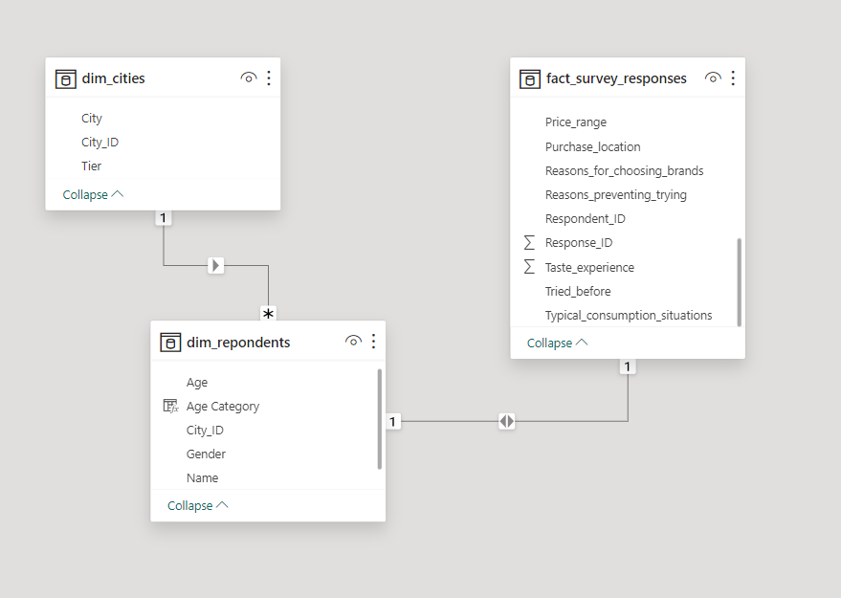
Relationship

Slide 5


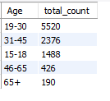

Demographic Insights
Who prefers energy drink more? Output :
Which age group prefers energy drinks more? Output :

Slide 6
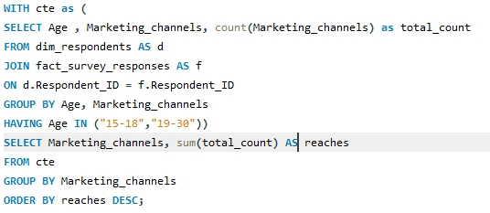
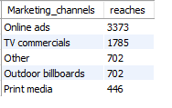
Demographic Insights
Which type of marketing reaches the most Youth (15-30)?
Oo Output :

Slide 7


Customer Preferences
What are the preferred ingredients of energy drinks among respondents?
Output :

Slide 8

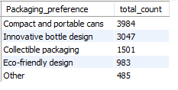
Customer Preferences
What packaging preferences do respondents have for energy drinks ?
Output :

Slide 9
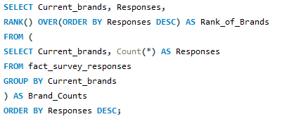
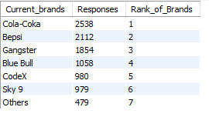
Competition Analysis
Who are the current market leaders? Output :

Slide 10
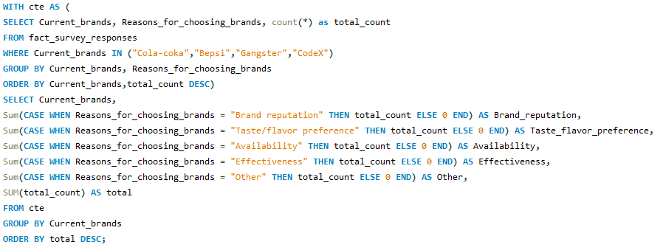
Competition Analysis
What are the primary reasons consumers prefer those brands over ours?

Slide 11

Competition Analysis
What are the primary reasons consumers prefer those brands over ours?
Output :

Slide 12
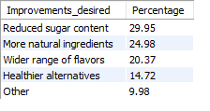
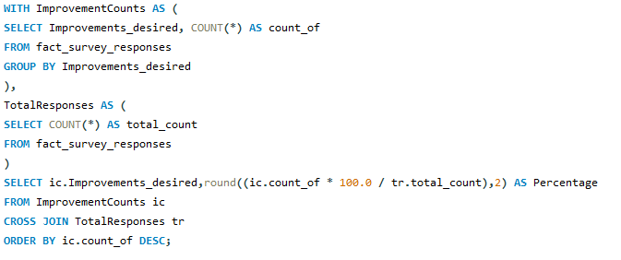
Competition Analysis
What are the most desired improvements required in energy drinks?
Output:

Slide 13

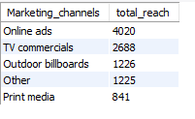
Marketing Insights
Which marketing channel can be used to reach more customers?
Output :

Slide 14
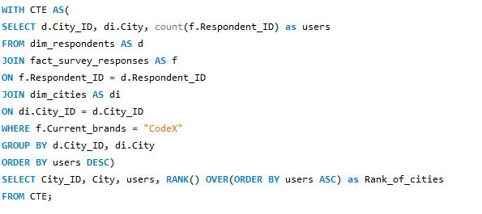
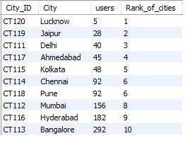
Marketing Insights
Which cities do we need to focus more on? Output :

Slide 15

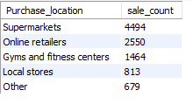
Purchase Behavior
Where do respondents prefer to purchase energy drinks?
Output :

Slide 16

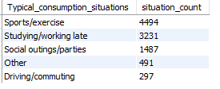
Purchase Behavior
What are the typical consumption situations for energy drinks among respondents?
Output :

Slide 17
Business Outcomes
CodeX ranks 5th out of 7 brands in terms of market position.
The most preferred price range is 50-99.
Most Consumer purchase 2-3 times a week.
Overall perception of our brand is Neutral.
Supermarkets and Online retailers are the most effective channels.
Bangalore leads with the highest responses while Lucknow and Jaipur has the lowest responses.
The 19-30 age group represent the largest segment for consumption.
Caffeine is the most sought-after ingredient followed by vitamins.

Slide 18
Business Outcomes
Health concern is the main reason not choosing our brand over other. Hence marketing our brands health benefits can increase the sales.
Implementing a reduction in sugar content and increase in natural ingredients, as suggested by 54% of respondents, could significantly boost sales and enhance our energy drinks market appeal.

Slide 19
Thank You

